Slide 1
Article Post
ORM / webservices: MIDTERM PROJECT
Group Member:
Chea Chan
Chea Devit
Neam Sinat

Slide 2
Agendas
Project Introduction
Project Scope
Project Features
Problems & Solutions
Questions & Answers

Slide 3
Introduction
Description: Article Post is a project to share about the news related to Entertainments, Sports, Technologies and Socials.
Technologies:
PHP Framework (Laravel)
Bootstrap 4
MySQL Database

Slide 4
Project Scope
Guest: Not require to login into our system they can view the articles post with the different categories and click for more detail for each post.
Admin User: require to login into our system with the Email & Password then they can work on Articles Management, User Management and Categories Management.

Slide 5
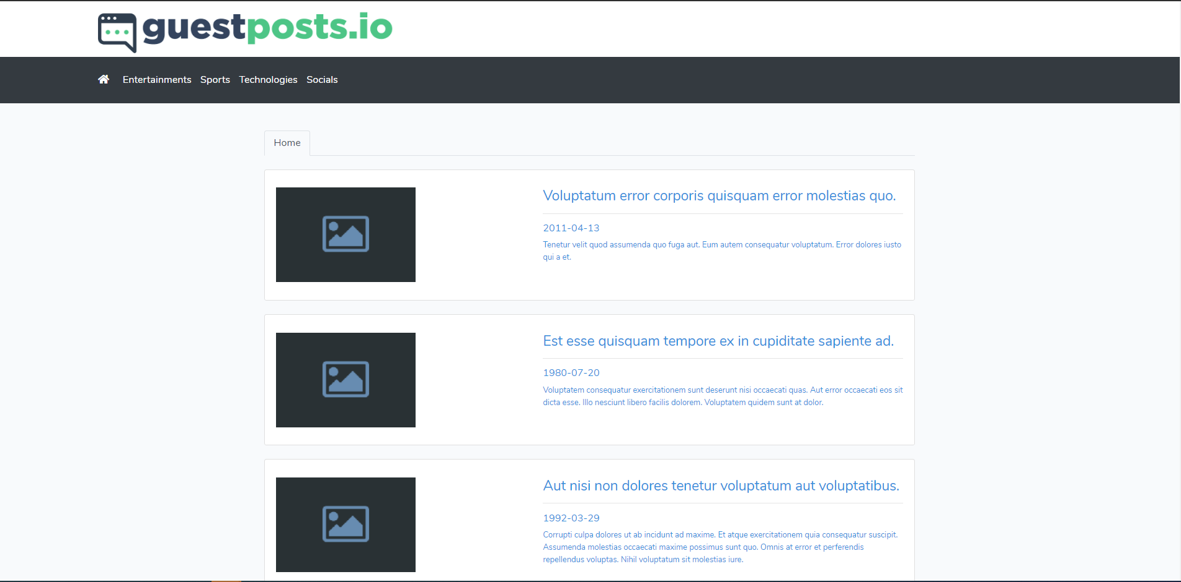
Project Features
Article List
Home Article

Slide 6
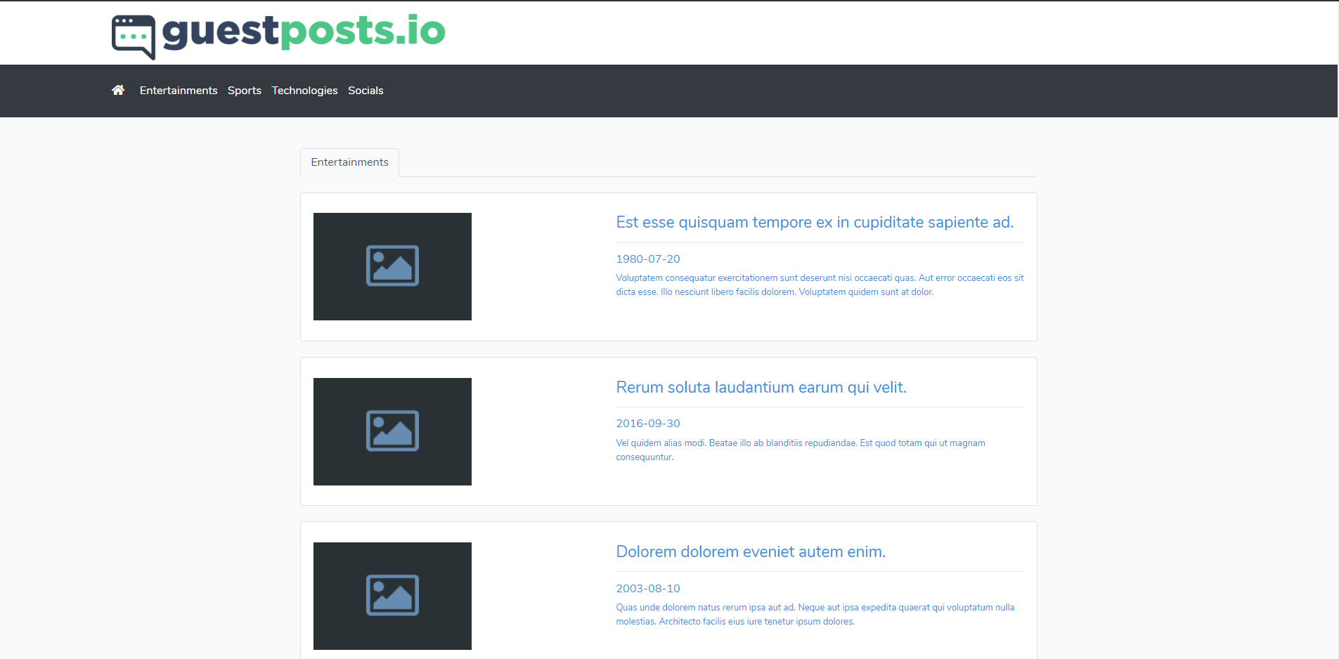
Project Features
Article List
Entertainments Article

Slide 7

Project Features
Article List
Sport Article

Slide 8
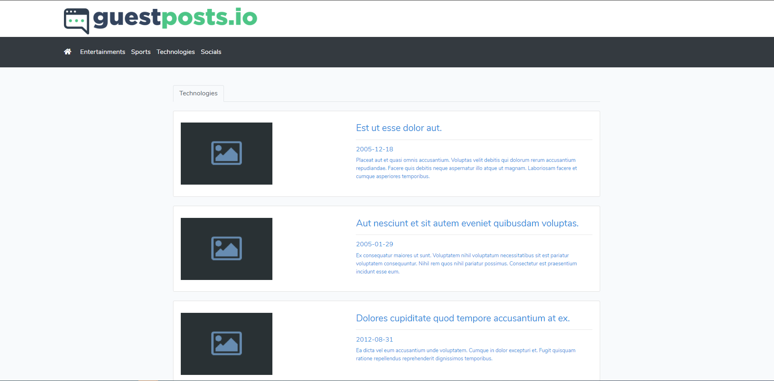
Project Features
Article List
Technology Article

Slide 9
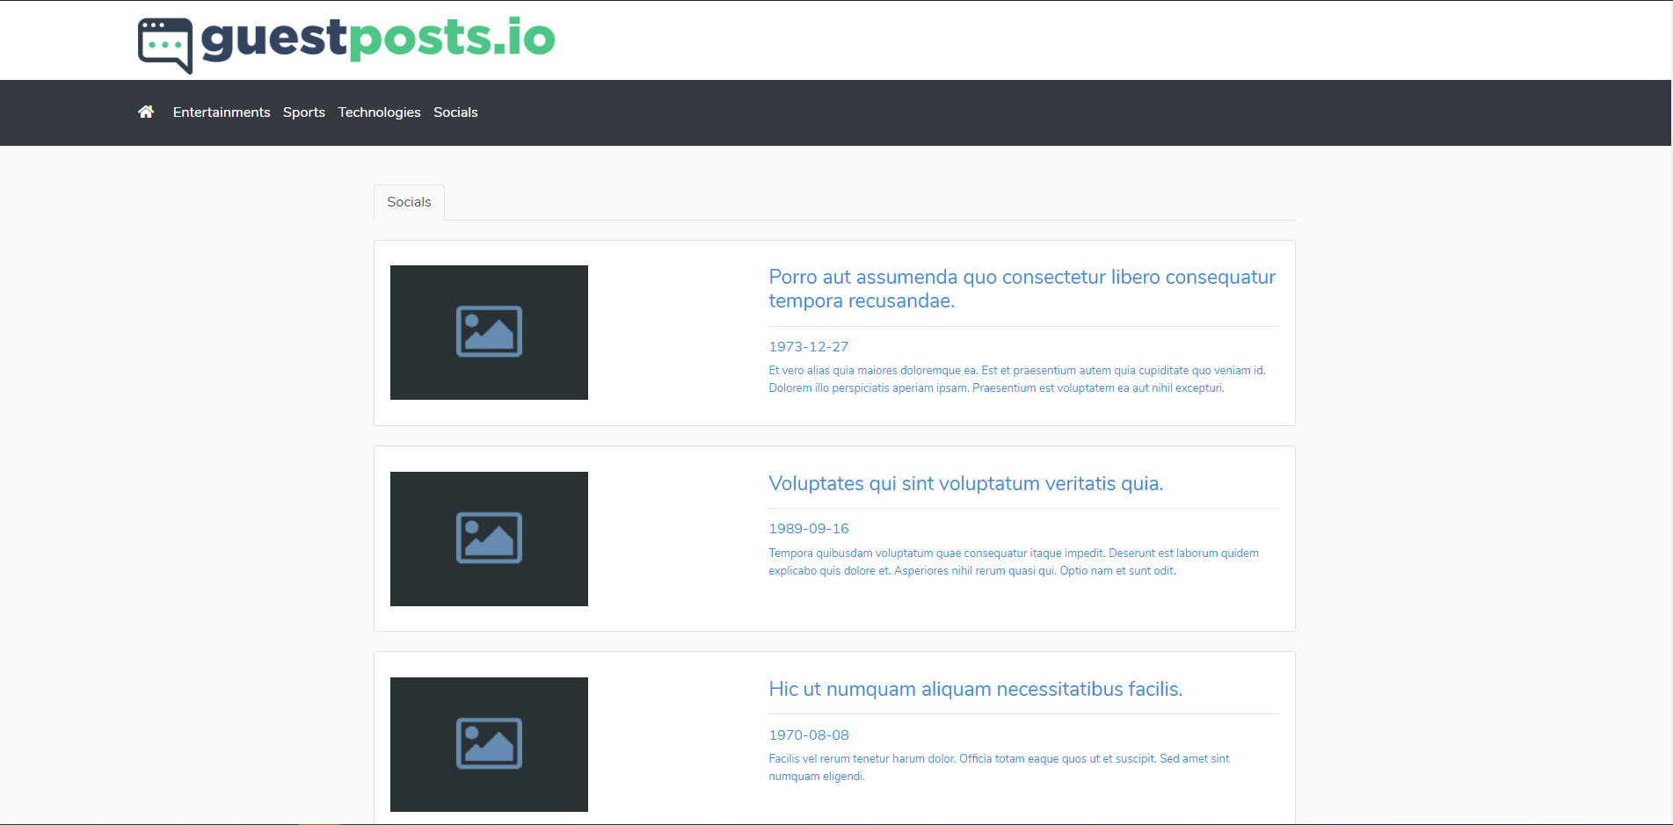
Project Features
Article List
Social Article

Slide 10
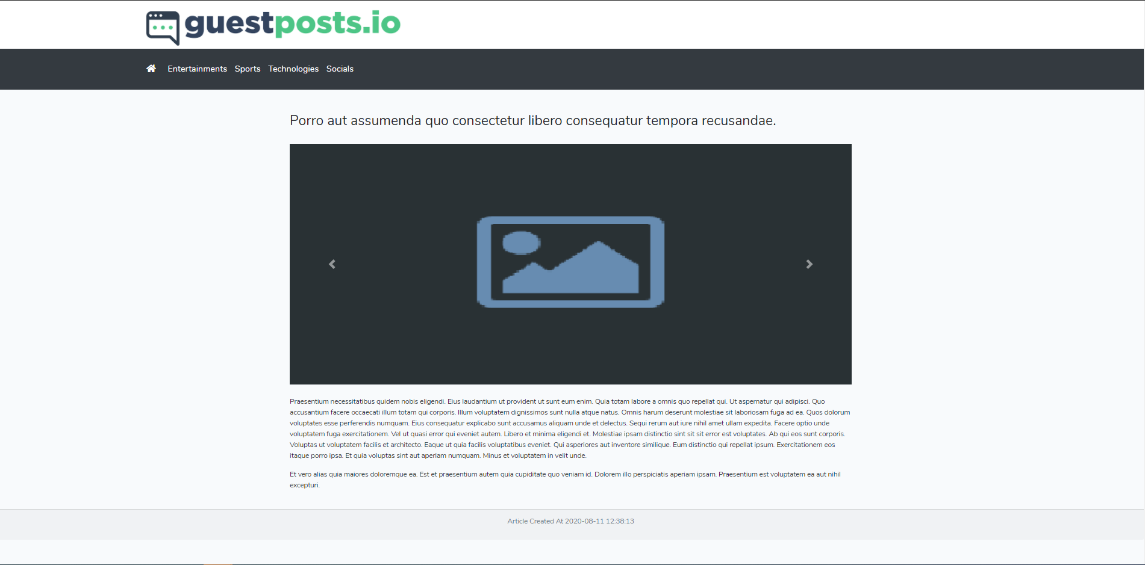
Project Features
Article List
Article Detail

Slide 11
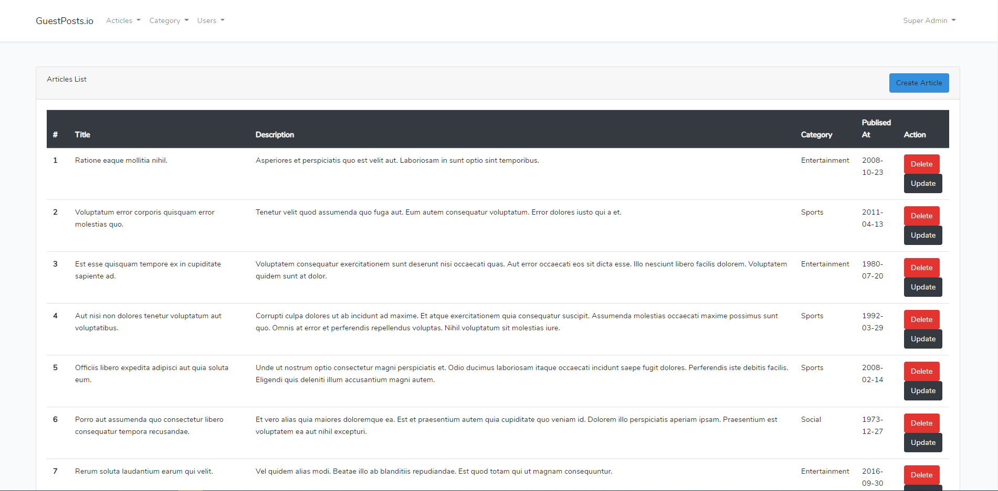
Project Features
Article Management
Article table list

Slide 12
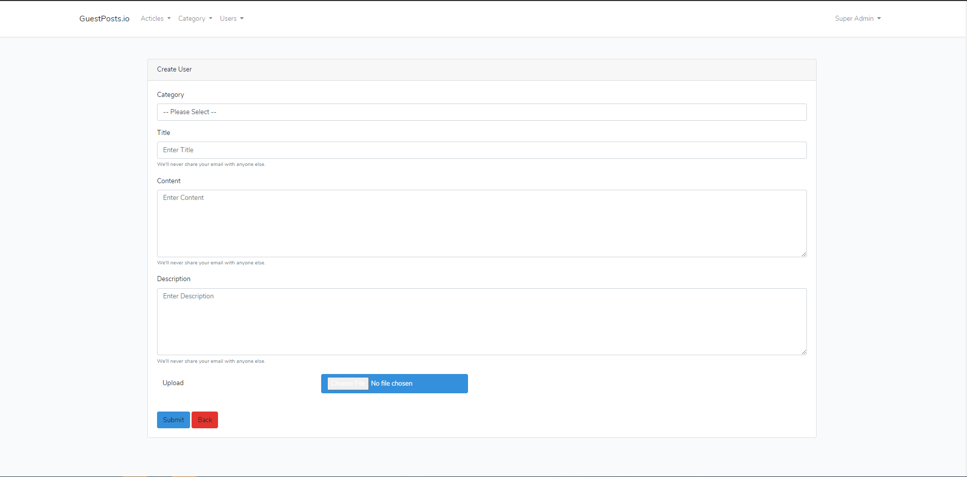
Project Features
Article Management
Add Article

Slide 13
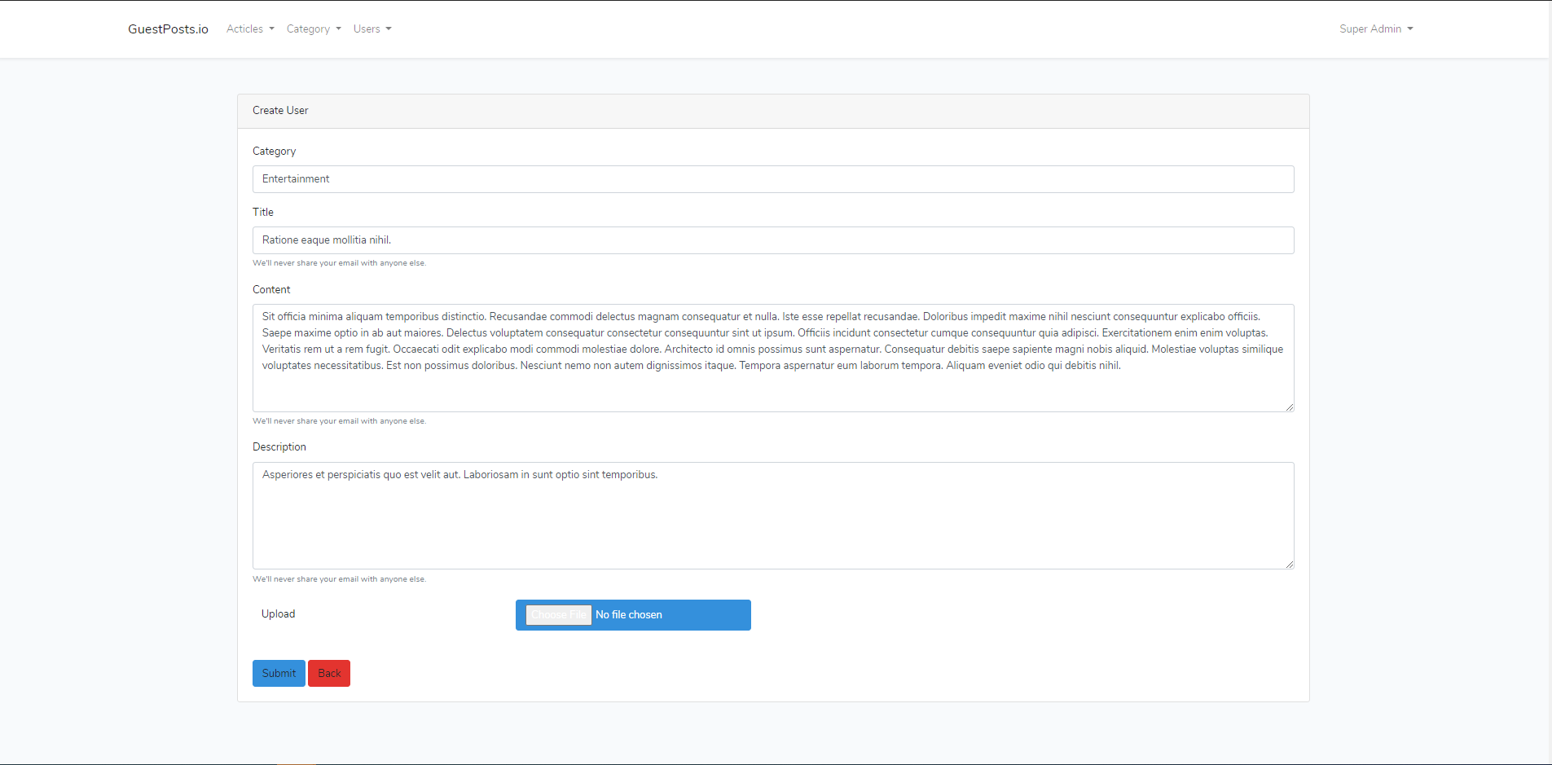
Project Features
Article Management
Edit Article

Slide 14
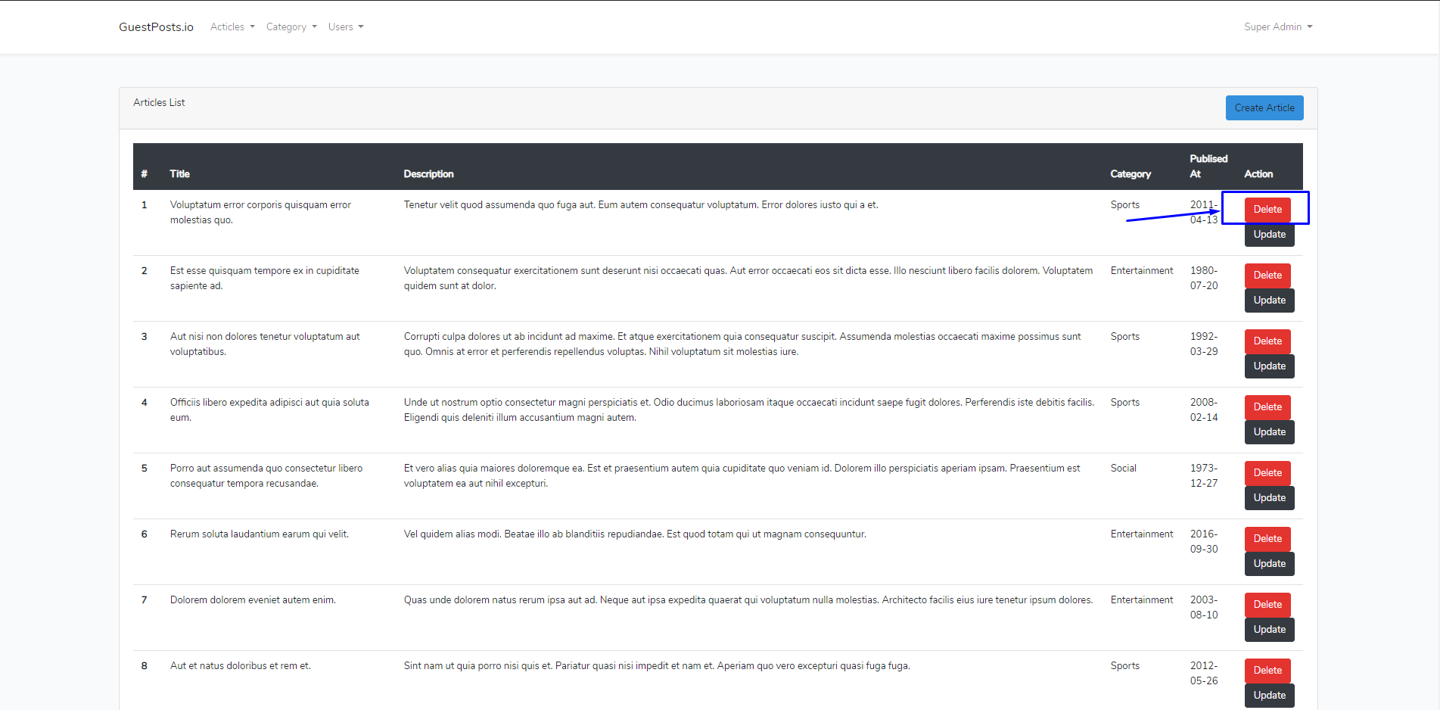
Project Features
Article Management
Delete Article

Slide 15
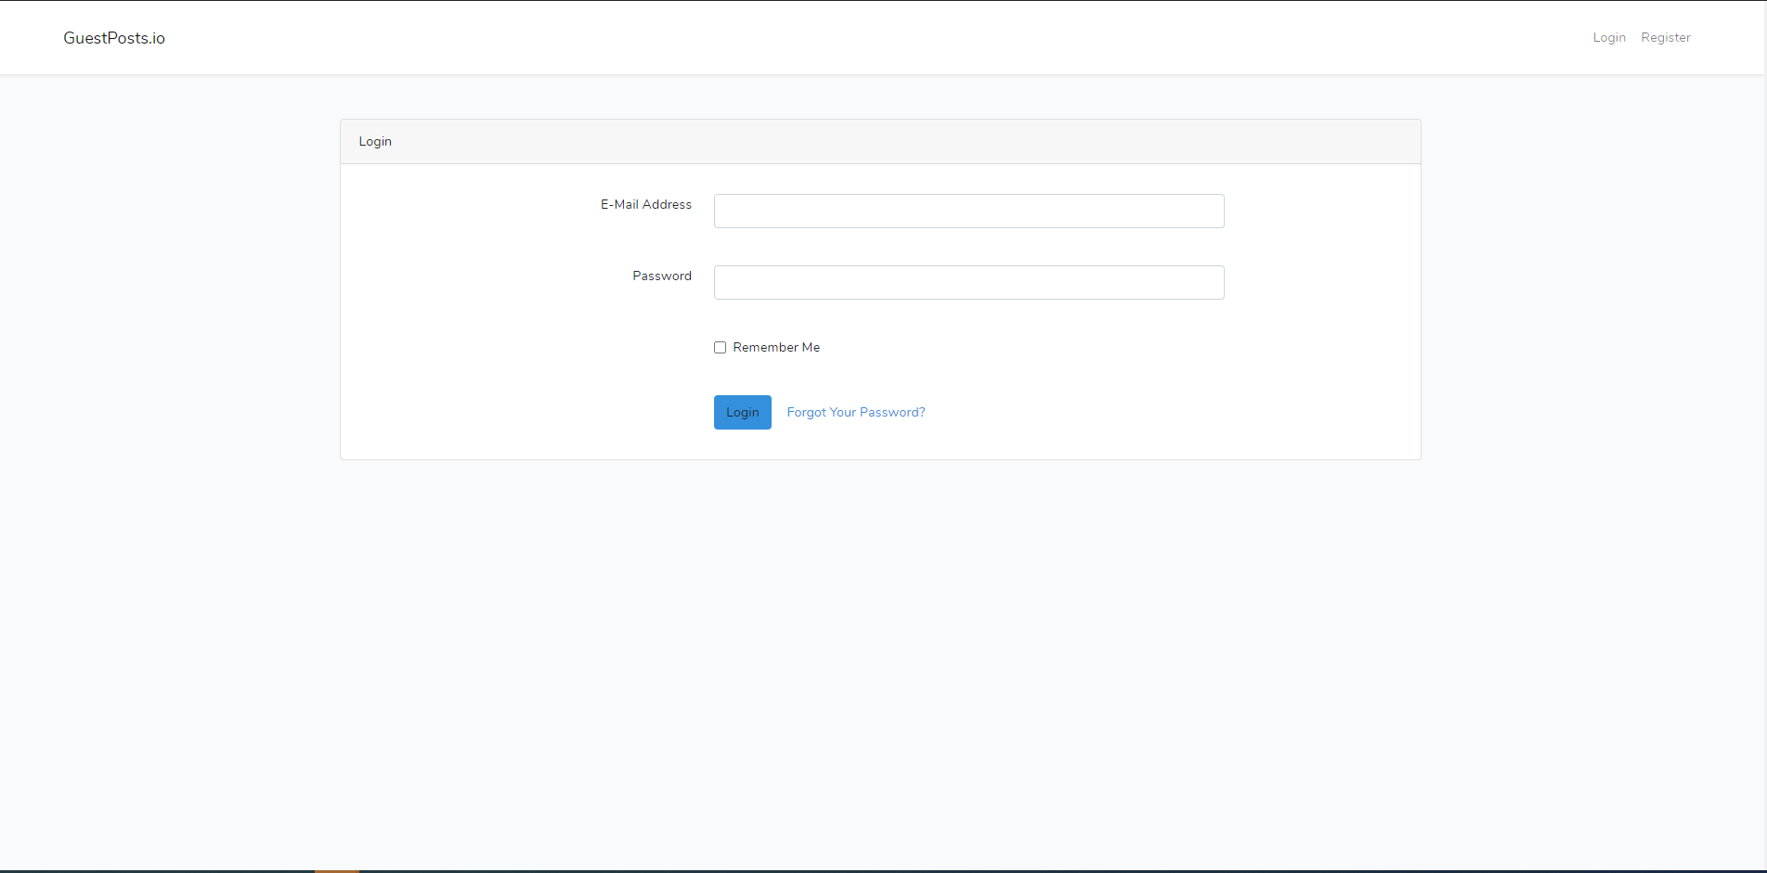
Project Features
User Management
User Login

Slide 16
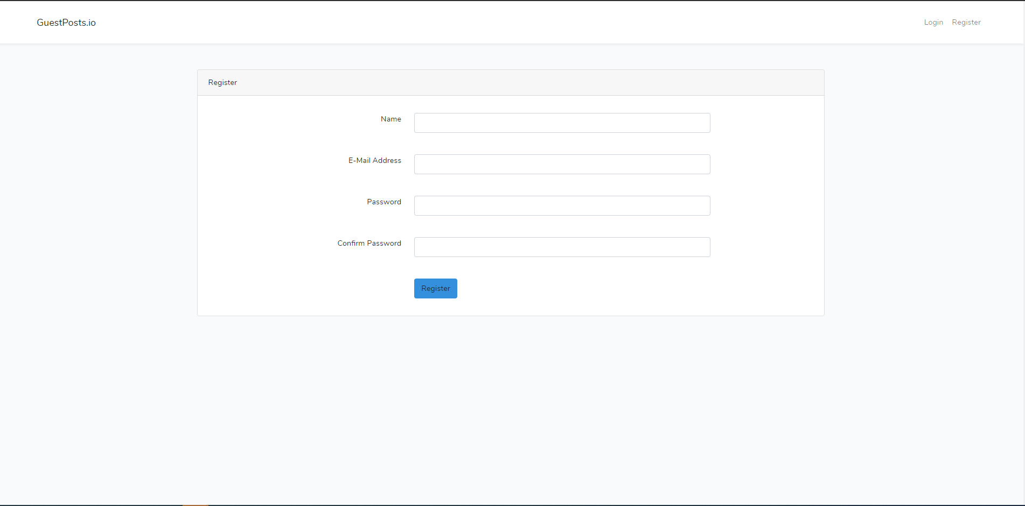
Project Features
User Management
User Register

Slide 17
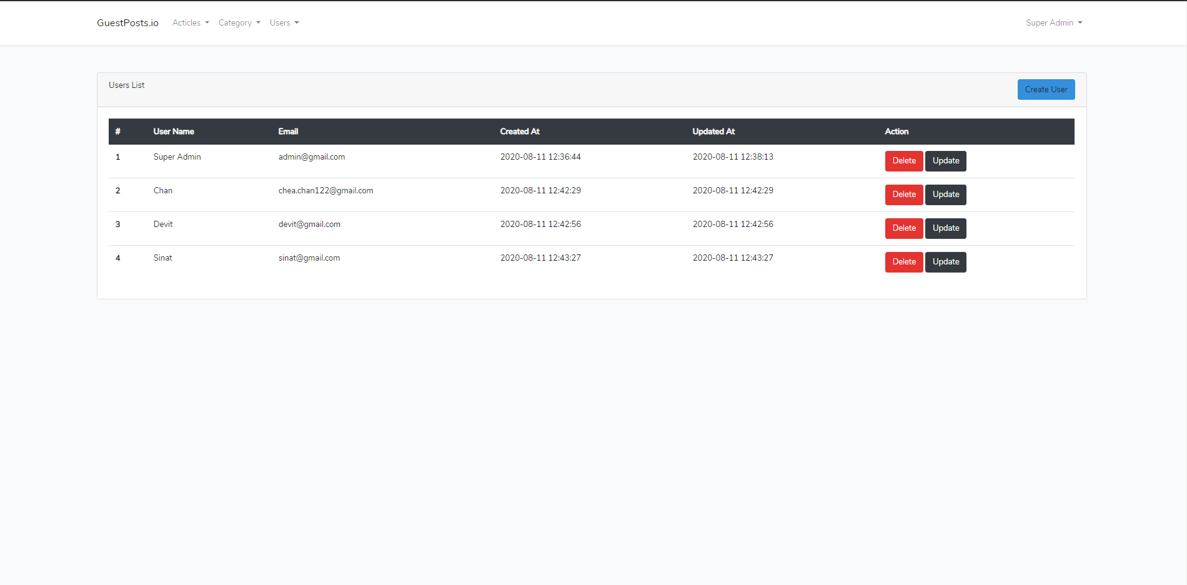
Project Features
User Management
User table list

Slide 18
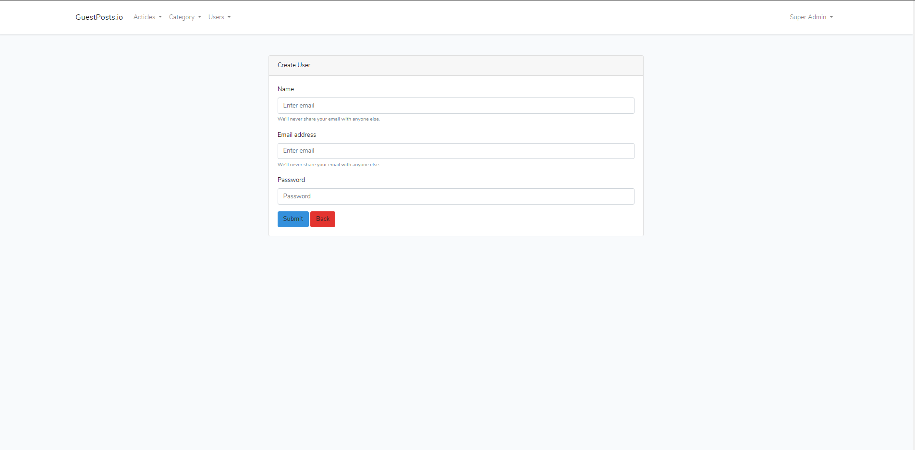
Project Features
User Management
Add User

Slide 19
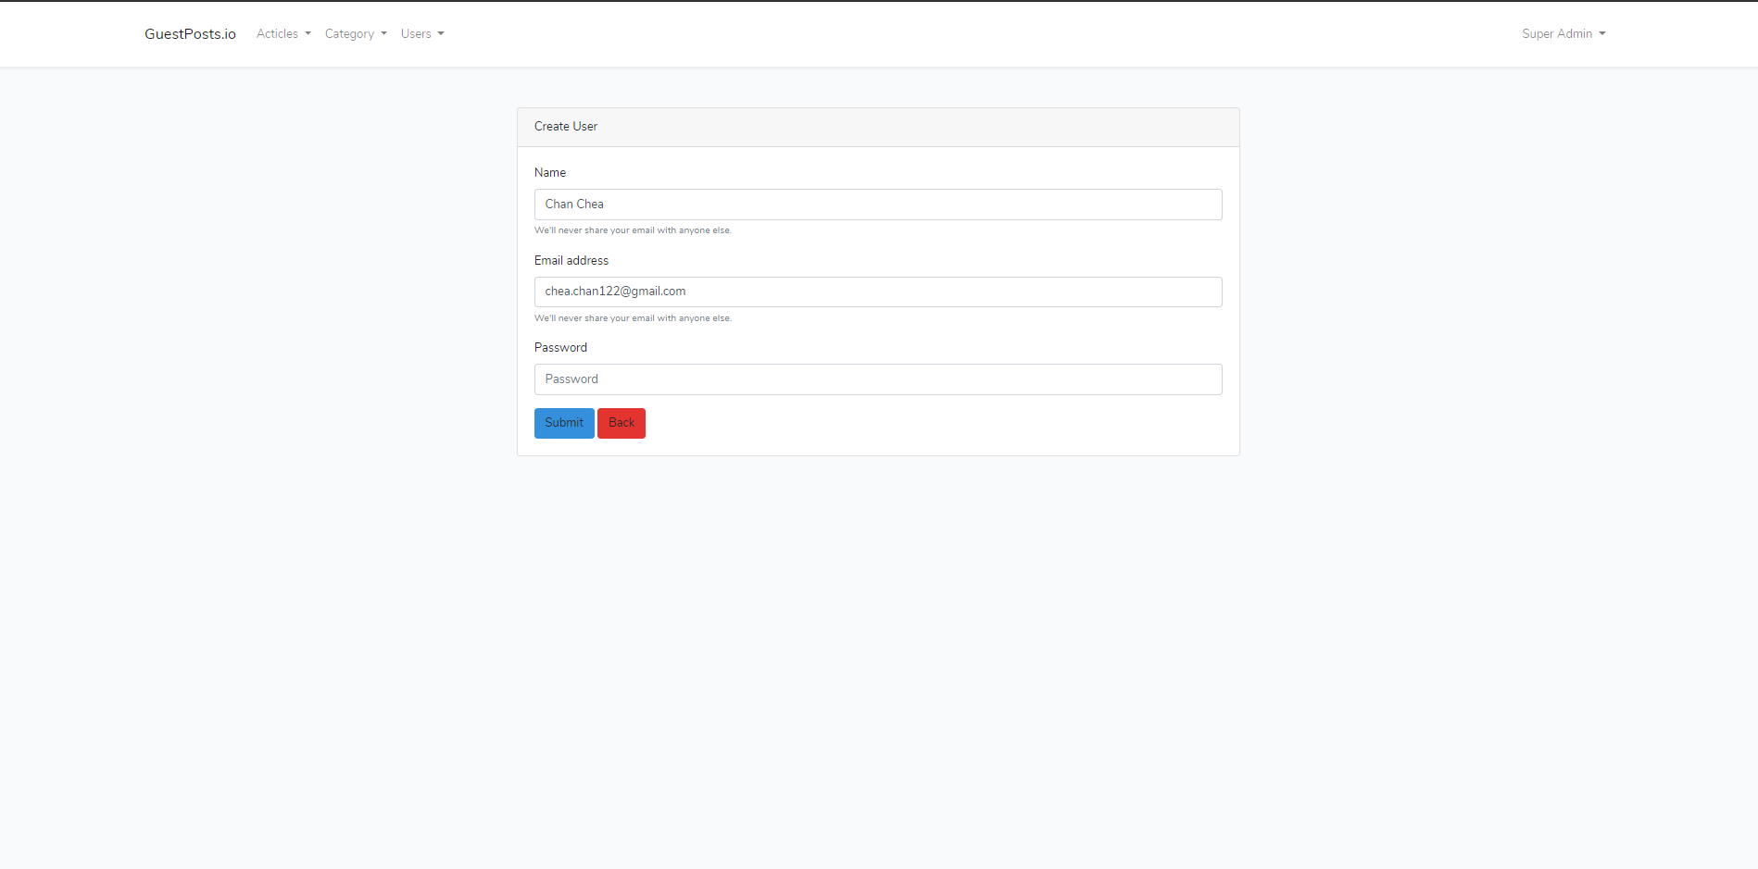
Project Features
User Management
Edit User

Slide 20
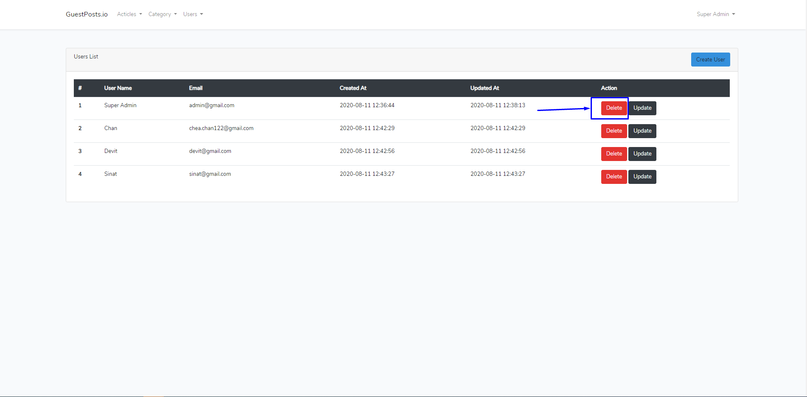
Project Features
User Management
Delete User

Slide 21
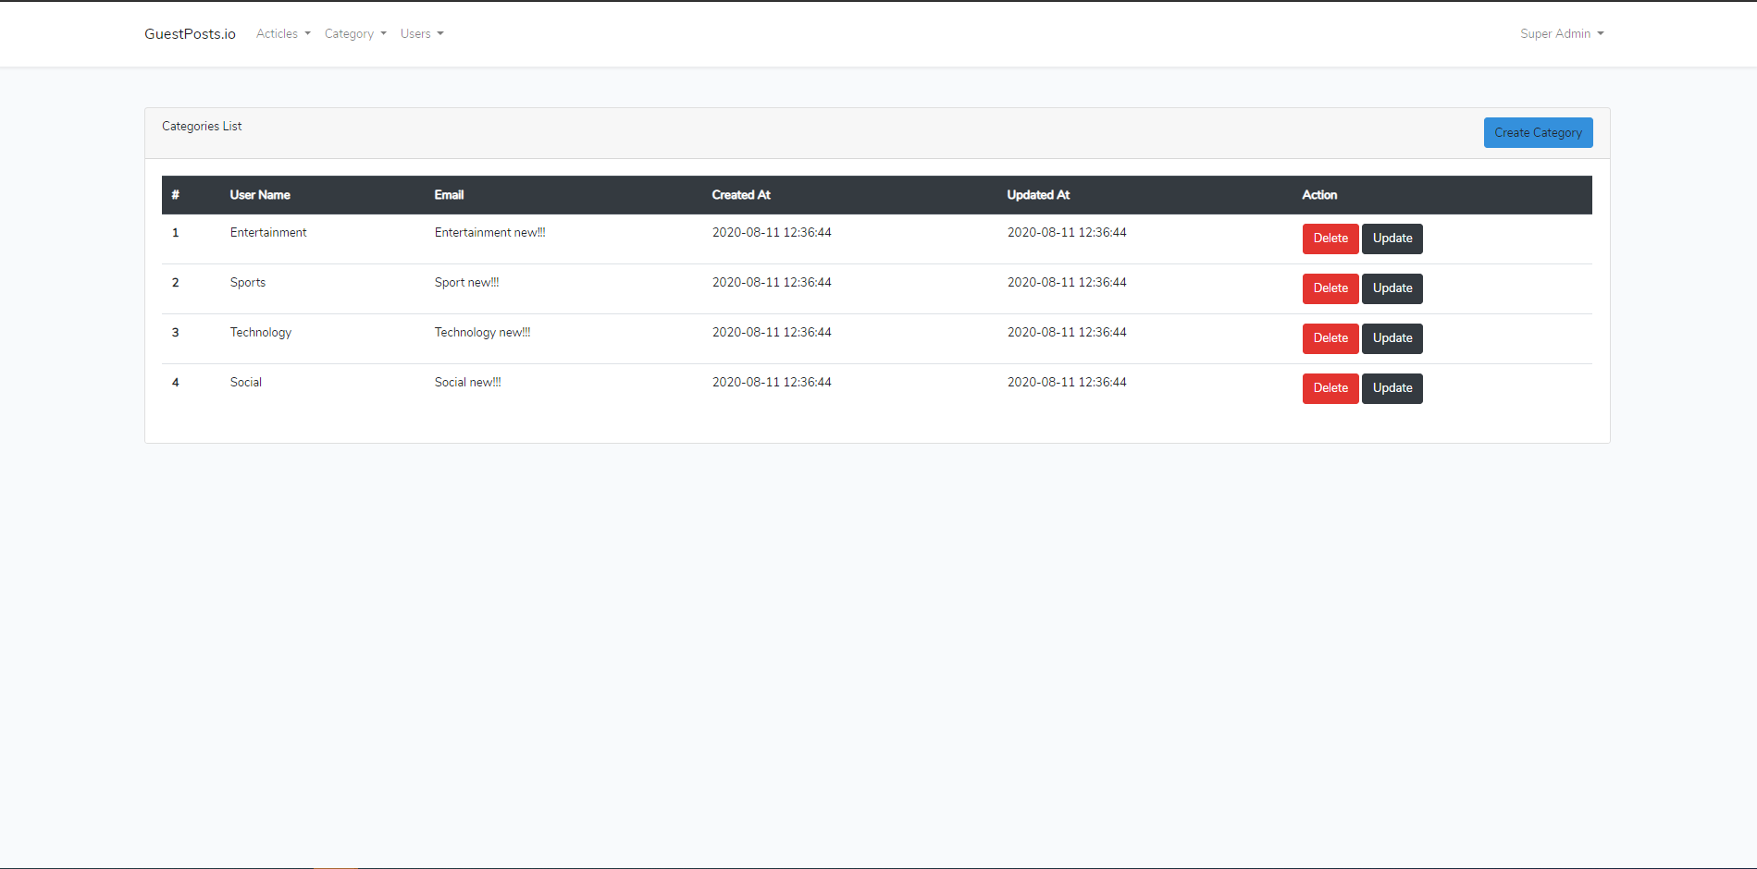
Project Features
Category Management
Category table list

Slide 22
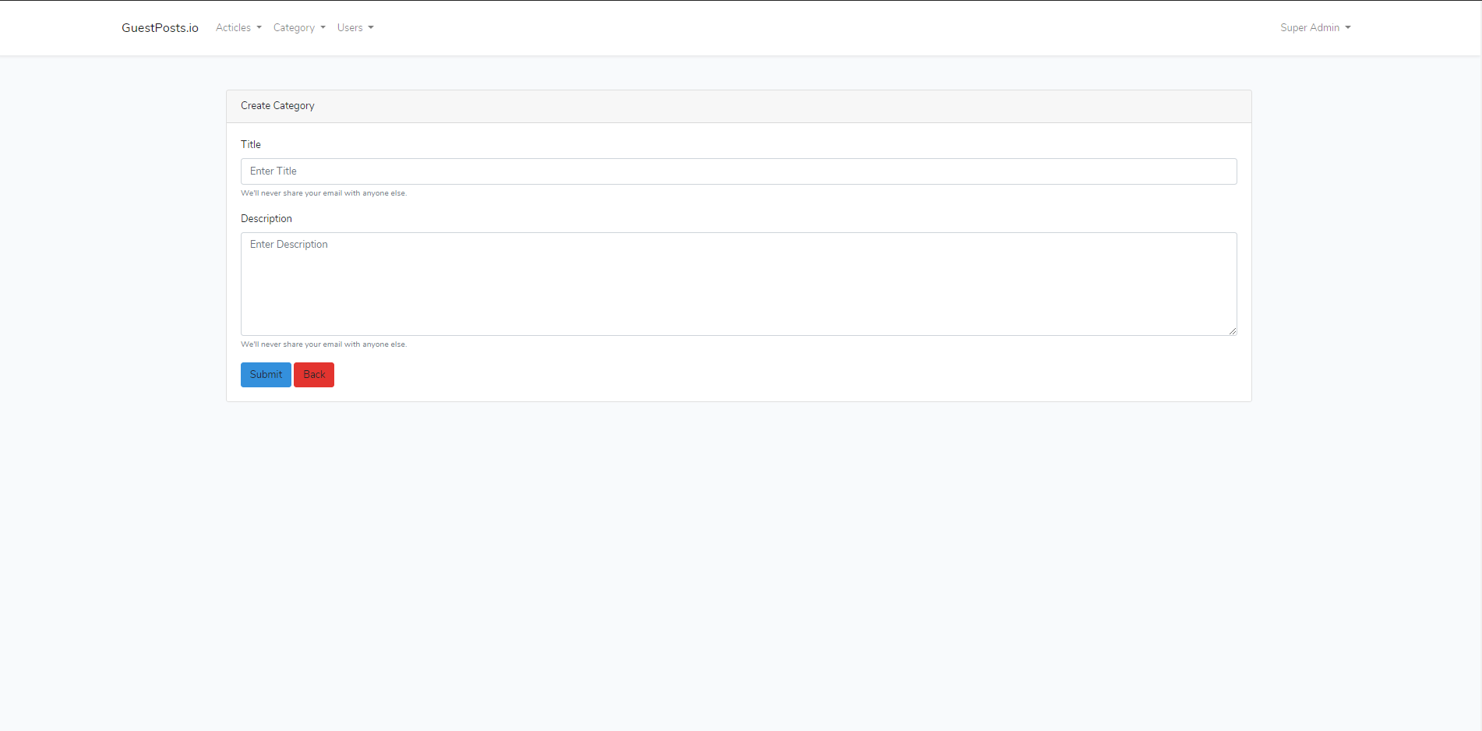
Project Features
Category Management
Add Category

Slide 23
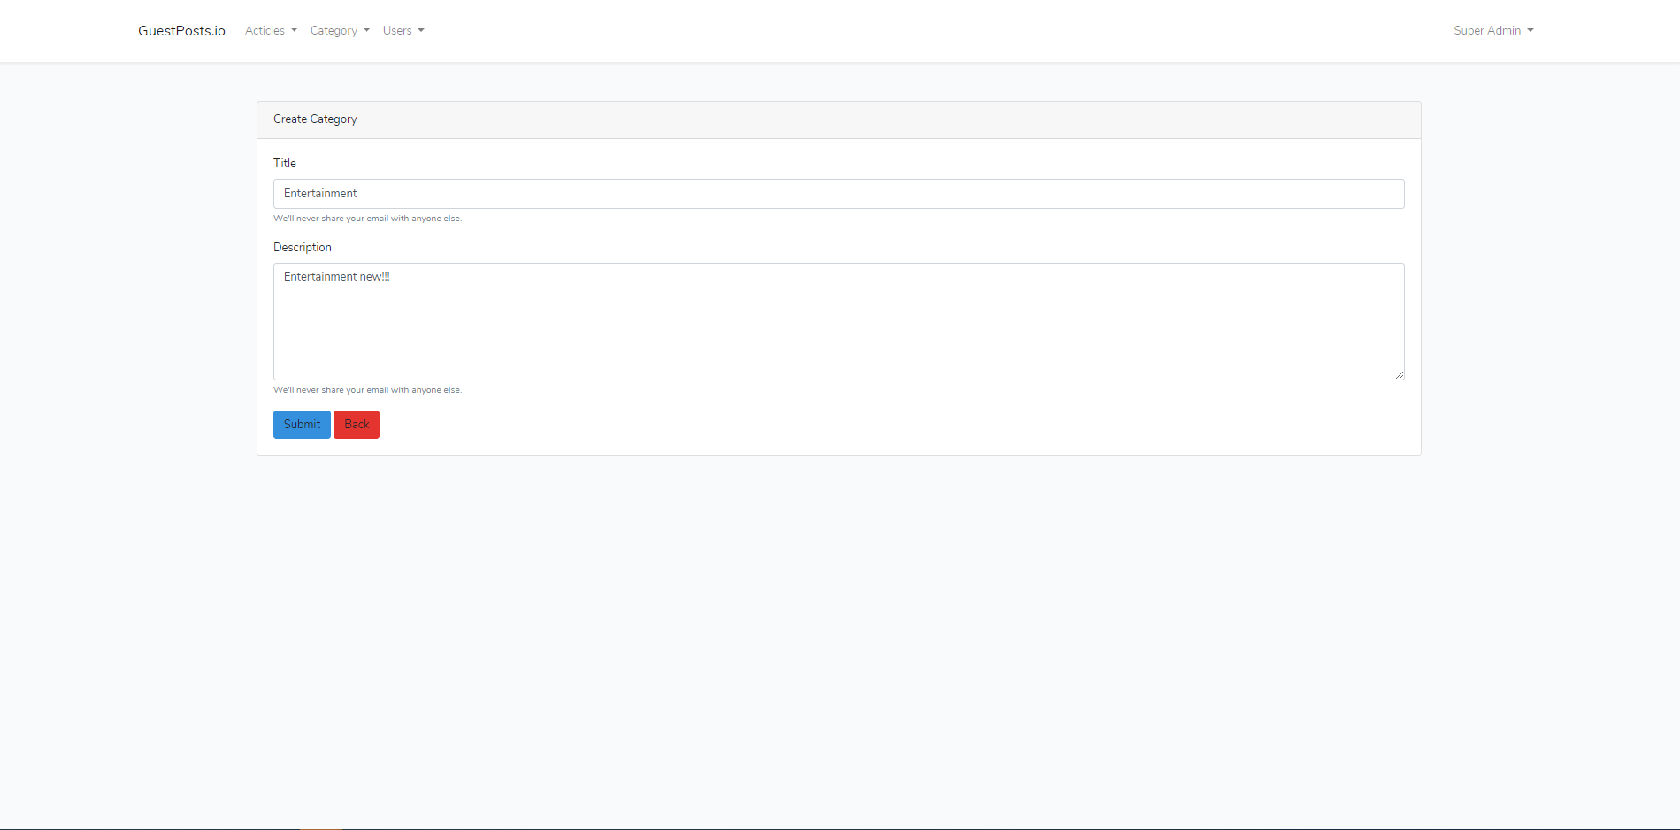
Project Features
Category Management
Edit Category

Slide 24
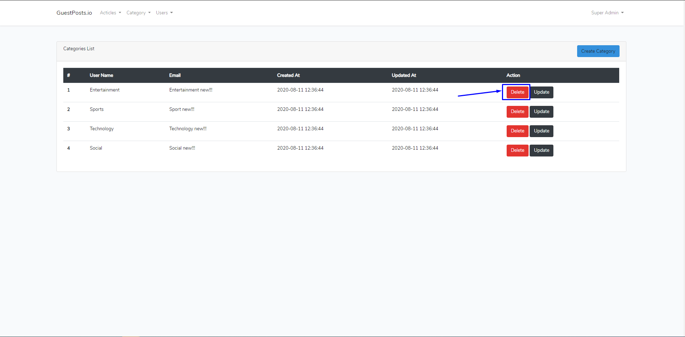
Project Features
Category Management
Delete Category

Slide 25
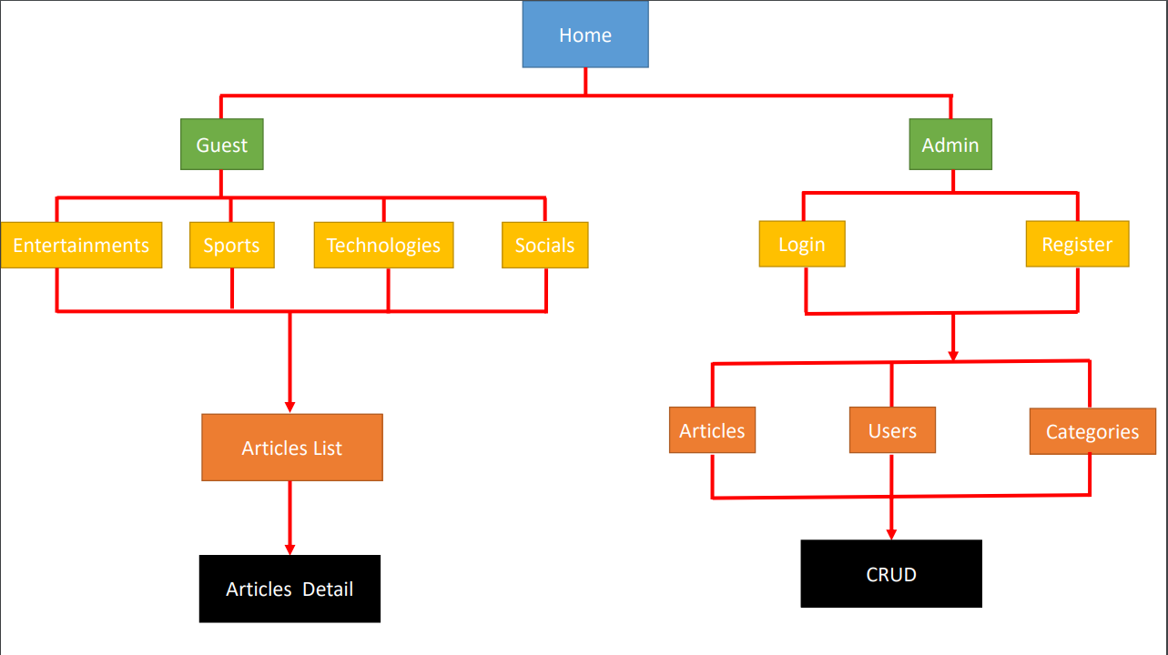
Sitemap

Slide 26
Problems & Solutions
Problem: Cannot install the Vue.js (Error Command: npm run dev)
Solution: Change to use bootstrap 4

Slide 27

Questions & Answers

Slide 28


